Slide 1
Cluster Analysis of Depressive Disorder Symptoms

Slide 2
Introduction
Objective:
Analyze mental health trends using a dataset on depressive disorder symptoms.
Identify patterns through clustering techniques.
Visualize insights for better understanding.
Variable:
Value (Percentage of individuals affected)
Low CI (Lower bound of confidence interval)
High CI (Upper bound of confidence interval)
Time Period (Year/Quarter)

Slide 3
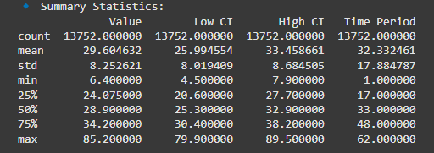
Summary Statistics

Slide 4
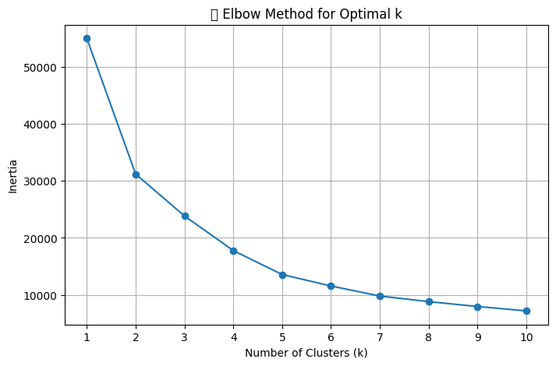
Interpretation: The "elbow point" (where the decrease in inertia slows down) is around k = 3, suggesting that 3 clusters is a good choice for K-Means clustering.

Slide 5
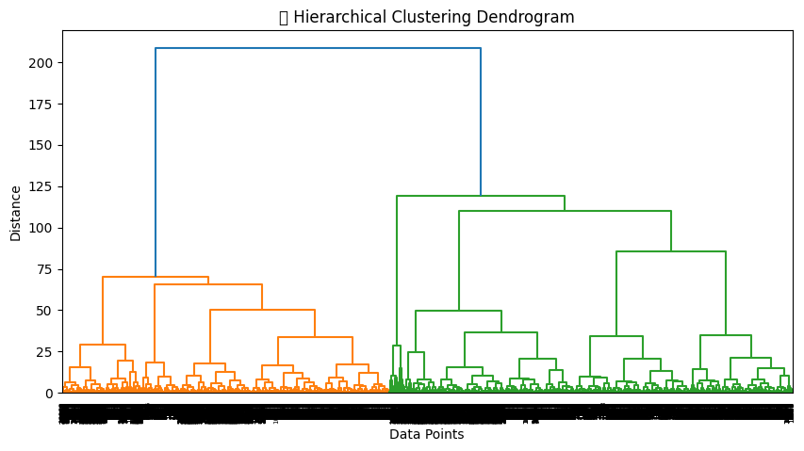
Interpretations: A natural cut-off suggests two or three clusters as a good choice.

Slide 6
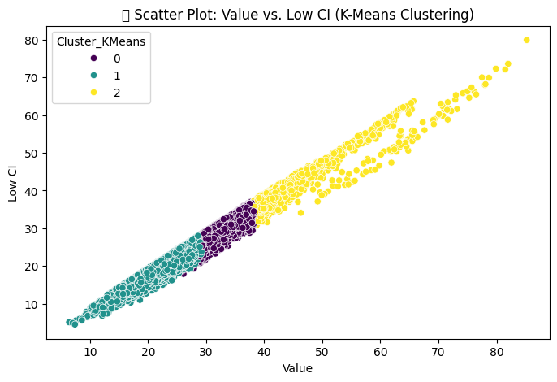
Interpretation: The clustering shows a clear pattern, where data points with higher "Value" tend to belong to a different cluster compared to those with lower values.

Slide 7
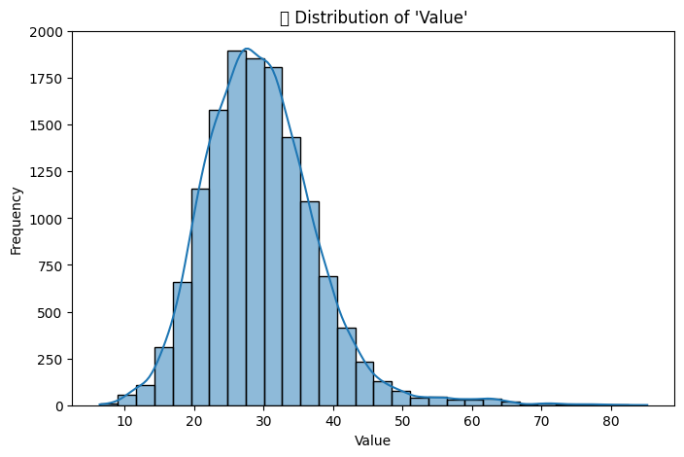
Interpretation: The histogram is normally Distributed.

Slide 8
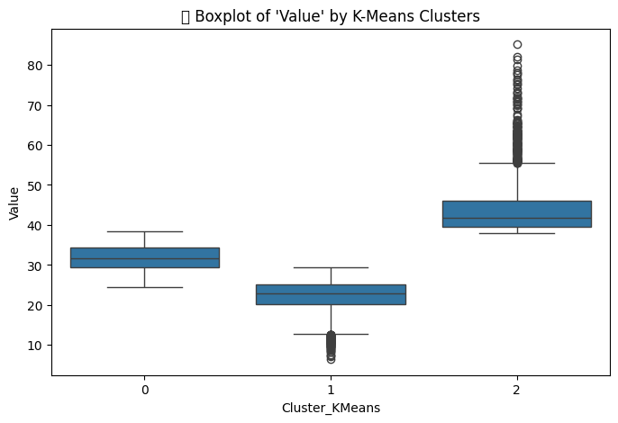
Interpretation: The boxplot reveals Cluster 2 has significantly higher 'Value' than others

Slide 9
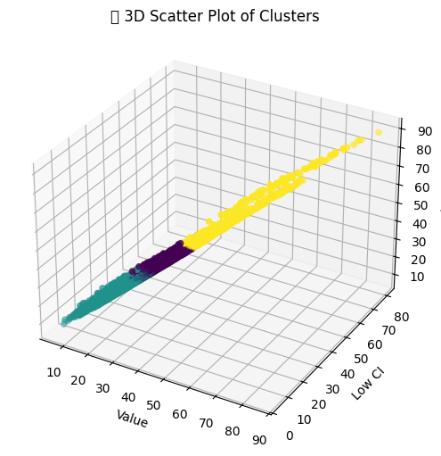
Interpretation: 3D plot shows clear spatial separation between clusters

Slide 10
Insights from Clustering Analysis
1️⃣ The data naturally groups into distinct clusters based on depressive disorder values.
2️⃣ K-Means and Hierarchical Clustering produce similar groupings, indicating robustness.
3️⃣ The spread of 'Value' and 'Low CI' suggests differences in trends across time periods.
4️⃣ Further analysis could explore whether certain states have significantly different trends.

